Slide 1
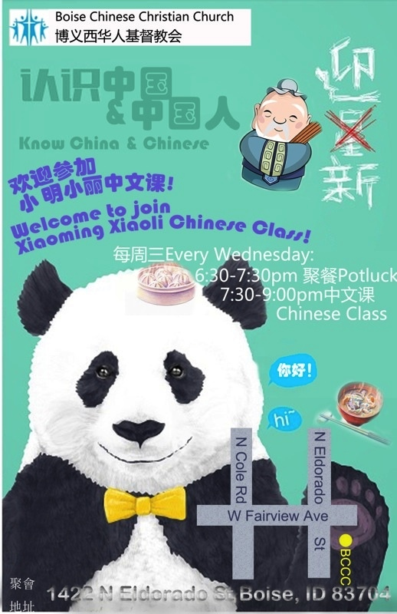
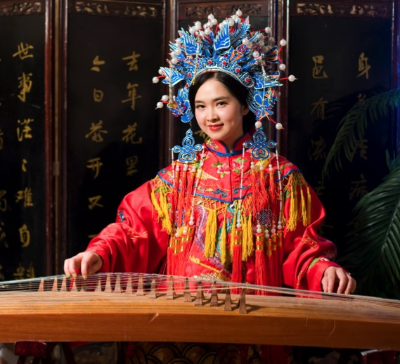
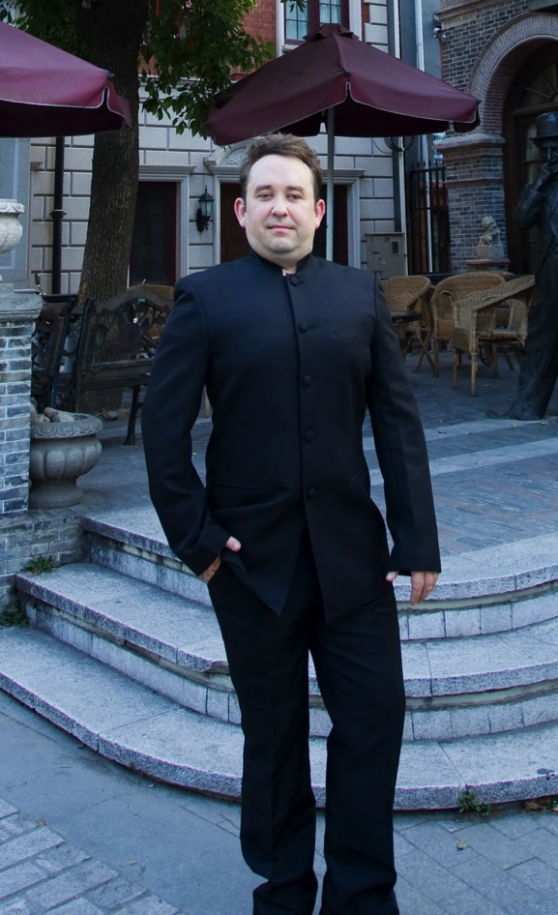

Slide 2
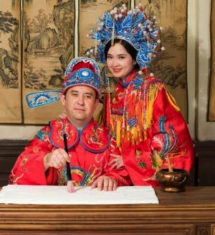
Teacher Xiao Ming & Teacher Xiao Li
Xiǎo Míng hé Xiao Lì Zhōngwén Kè
小明和小丽中文课
BCCC Chinese Classes
Mandarin Chinese – Beginners
Lesson 3 第3课
2014年09月03日
Email: zhongwenke@boiseccc.org
Phone: 208.409.6665 (Rich)
208.409.8532 (Audrey)
Website: http://zhongwenke.boiseccc.org

Slide 3
Pronunciation
发音
fā yīn
Initials
b p m f d t n l g k h j q x zh ch sh r
Finals
a ai an ang ao e ei en eng er i ia ian iang iao ie in ing iong iou o ong ou u ui ua uai uan uang uei uen ueng uo ü(u) üan(uan) üe(ue) ün(un)
Syllables
413 possible syllables (excluding tones, 2000 with, English has about 12,000 possible syllables) A B C D E F G H J K L M N O P Q R S T W X Y Z
→ (see diagrams at http://zhongwenke.boiseccc.org)

Slide 4
a, ai, an, ang, ao
ba, bai, ban, bang, bao, bei, ben, beng, bi, bian, biao, bie, bin, bing, bo, bu
ca, cai, can, cang, cao, ce, cei, cen, ceng, cha, chai, chan, chang, chao, che, chen, cheng, chi, chong, chou, chu, chua, chuai, chuan, chuang, chui, chun, chuo, ci, cong, cou, cu, cuan, cui, cun, cuo
da, dai, dan, dang, dao, de, dei, den, deng, di, dian, diao, die, ding, diu, dong, dou, du, duan, dui, dun, duo
e, ê, ei, en, er
fa, fan, fang, fei, fen, feng, fo, fou, fu
ga, gai, gan, gang, gao, ge, gei, gen, geng, gong, gou, gu, gua, guai, guan, guang, gui, gun, guo
ha, hai, han, hang, hao, he, hei, hen, heng, hm, hng, hong, hou, hu, hua, huai, huan, huang, hui, hun, huo
ji, jia, jian, jiang, jiao, jie, jin, jing, jiong, jiu, ju, juan, jue, jun
ka, kai, kan, kang, kao, ke, kei, ken, keng, kong, kou, ku, kua, kuai, kuan, kuang, kui, kun, kuo
la, lai, lan, lang, lao, le, lei, leng, li, lia, lian, liang, liao, lie, lin, ling, liu, long, lou, lu, luo, luan, lun, lü, lüe
m, ma, mai, man, mang, mao, mei, men, meng, mi, mian, miao, mie, min, ming, miu, mo, mou, mu
n, na, nai, nan, nang, nao, ne, nei, nen, neng, ng, ni, nian, niang, niao, nie, nin, ning, niu, nong, nou, nu, nuo, nuan, nü, nüe
o, ou
pa, pai, pan, pang, pao, pei, pen, peng, pi, pian, piao, pie, pin, ping, po, pou, pu
qi, qia, qian, qiang, qiao, qie, qin, qing, qiong, qiu, qu, quan, que, qun
ran, rang, rao, re, ren, reng, ri, rong, rou, ru, rua, ruan, rui, run, ruo
sa, sai, san, sang, sao, se, sei, sen, seng, sha, shai, shan, shang, shao, she, shei, shen, sheng, shi, shou, shu, shua, shuai, shuan, shuang, shui, shun, shuo, si, song, sou, su, suan, sui, sun, suo
ta, tai, tan, tang, tao, te, teng, ti, tian, tiao, tie, ting, tong, tou, tu, tuan, tui, tun, tuo
wa, wai, wan, wang, wei, wen, weng, wo, wu
xi, xia, xian, xiang, xiao, xie, xin, xing, xiong, xiu, xu, xuan, xue, xun
ya, yan, yang, yao, ye, yi, yin, ying, yong, you, yu, yuan, yue, yun
za, zai, zan, zang, zao, ze, zei, zen, zeng, zha, zhai, zhan, zhang, zhao, zhe, zhei, zhen, zheng, zhi, zhong, zhou, zhu, zhua, zhuai, zhuan, zhuang, zhui, zhun, zhuo, zi, zong, zou, zu, zuan, zui, zun, zuo

Slide 5
The much hated (loved?) ‘U’
Syllables spelled with "u", but pronounced with "ü":
ju, juan, jue, jun
qu, quan, que, qun
xu, xuan, xue, xun
yu, yuan, yue, yun
Syllables where "u" and "ü" must NOT be mixed up:
lu, lü, lüe
nu, nü, nüe

Slide 6
Tones
声调
shēng diào
In Chinese it is always very important to pronounce words with correct tone.
In transliterated Chinese (Pinyin), tone markings are written over the central vowels in most syllables.
Some syllables have no specific tone, and then no sign is put above any vowel. This is neutral tone. Example would be the second ‘ma’ in ‘māma’ 妈妈

Slide 7
Tones (Cont.)
声调
shēng diào
The 1:st tone is marked with a line ("a" + "-" = "ā"). This is a high, even and constant tone.
The 2:nd tone is marked with a rising line ("a" + "´" = "á"). This is a rising tone that grows stronger.
The 3:rd tone is marked with a hook ("a" + "v" = "ă"). This tone is first falling and fading, then rising and growing strong.
The 4:th tone is marked with a falling line ("a" + "`" = "à"). This is a quickly falling and fading tone.

Slide 8
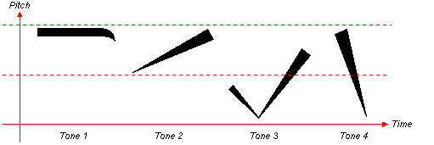
Tones (Cont.)
声调
shēng diào
1st tone: ā 3rd tone: ă
2nd tone: á 4th tone: à

Slide 9
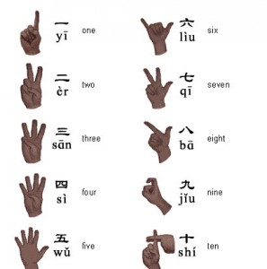
Numbers
数字
shù zì

Slide 10
Dialogue
对话
duì huà
A: Nǐ hǎo!
B: Nín hǎo. Yào mǎi shénme?
A: Zhè ge ___ duō shǎo qián?
B: ___ # kuài qián.
A: Hǎo de. Wǒ yào mǎi # ge.
píng guǒ (apple)
júzi (mandrin orange)
xī guā (watermelon)
A: 你好！
B: 您好。要买什么？
A: 这个____多少钱？
B: _____#块钱。
A: 好的.我要买#个。
苹果
橘子
西瓜

Slide 11
Vocabulary
生词
shēng cí
你好 nǐ hǎo hello (lit. you-good)
您好 nín hǎo hello, greetings (formal)
要 yào want, will
买 mǎi buy, purchase
什么 shén me what
这 zhè this
个 ge unit of measure, a (generic measure word)
苹果 píng guǒ apple
橘子 jú zi mandarin orange
西瓜 xī guā watermelon
多少 duō shǎo How much (lit. much-few)
钱 qián money
块 kuài dollar amount for Chinese money, RMB
好的 hǎo de ok, good
我 wǒ I, me

Slide 12
English Translation
A: Hello!
B: Greetings. What do you want to buy?
A: How much is this _______?
B: _____ are # RMB.
A: Ok. I want to buy #.

